Slide 1

Credit Card Strategy Analysis: Unlocking Customer Insights
This presentation delves into a comprehensive analysis of customer data to refine our card strategy, focusing on transaction behaviour, age demographics, and income categories.

Slide 2
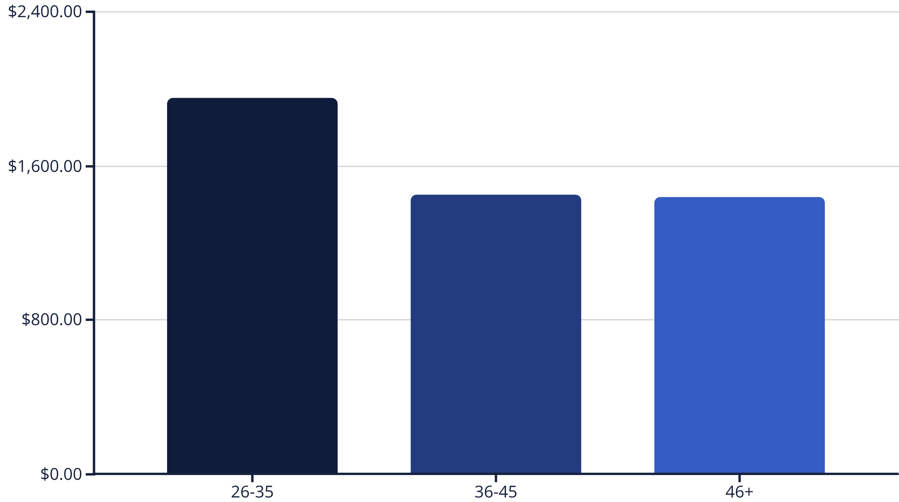
Average Transaction Amount by Age Group
Our analysis reveals that the 26-35 age group exhibits the highest average transaction amount, indicating a key demographic for targeted strategies. The 36-45 and 46+ groups show similar average spending.

Slide 3

Customer Demographics Overview
Understanding our customer base is crucial for tailoring effective card strategies. We observe a diverse range of ages, income levels, and gender distribution.
Age Groups: 26-35, 36-45, 46+
Gender Distribution: Male and Female customers
Income Categories: Less than $40K, $40K - $60K, $60K - $80K,
$80K - $120K, $120K +
Client Numbers: A large and varied customer base.

Slide 4
Income Category Distribution
Less than $40K
$40K - $60K
$60K - $80K
Significant portion of our customer base falls into this income bracket.
A substantial segment with moderate spending potential.
Represents a key demographic for premium card offerings.
$80K - $120K
$120K +
High-value customers with strong purchasing power.
Our most affluent customers, ideal for exclusive benefits.

Slide 5


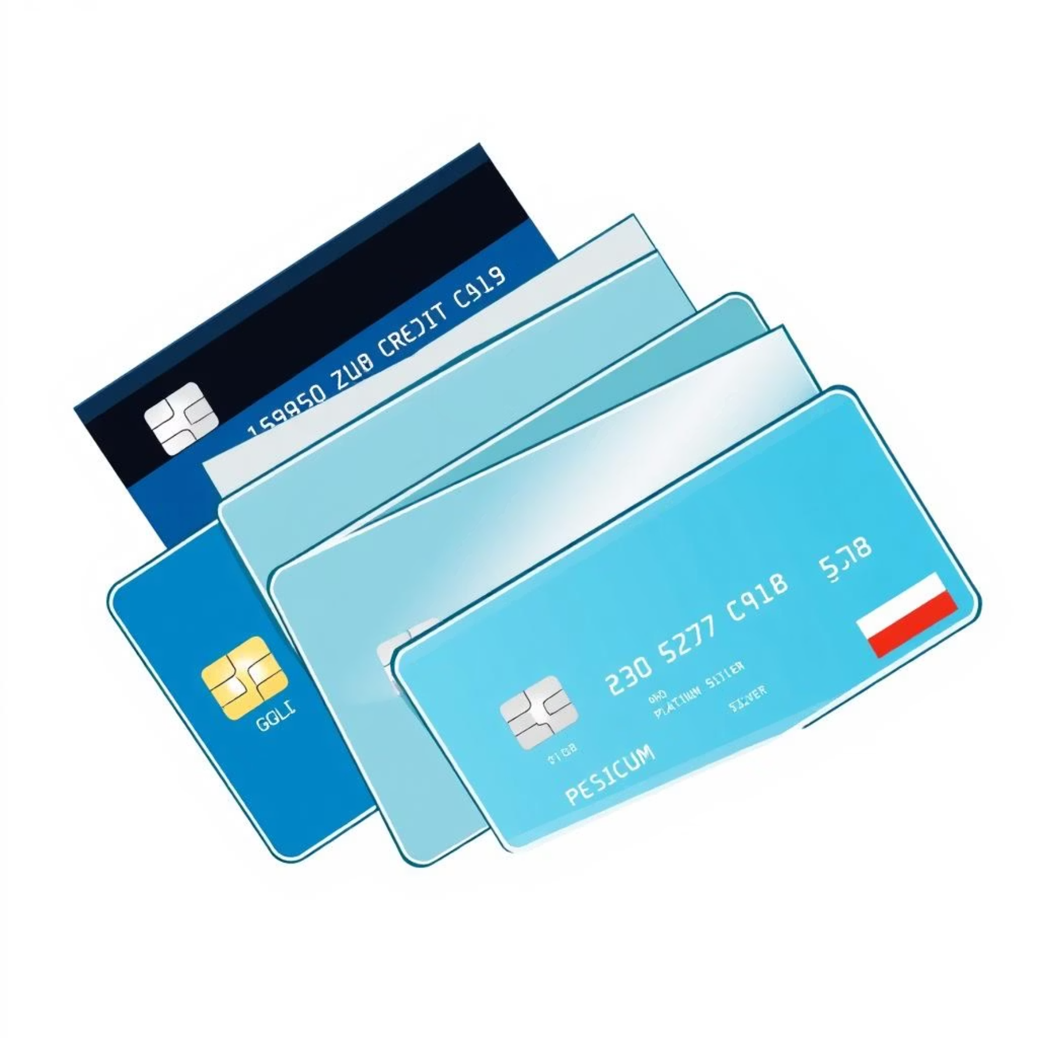


Card Categories and Utilization
We offer various card categories: Blue, Gold, Platinum, and Silver. Each category caters to different customer needs and spending habits.
The average utilization ratio across all cards is approximately 27%, indicating
room for encouraging higher engagement.
6%
5%
Silver Card Avg Utilization
Blue Card Avg Utilization
7%
4%
Gold Card Avg Utilization
Platinum Card Avg Utilization

Slide 6
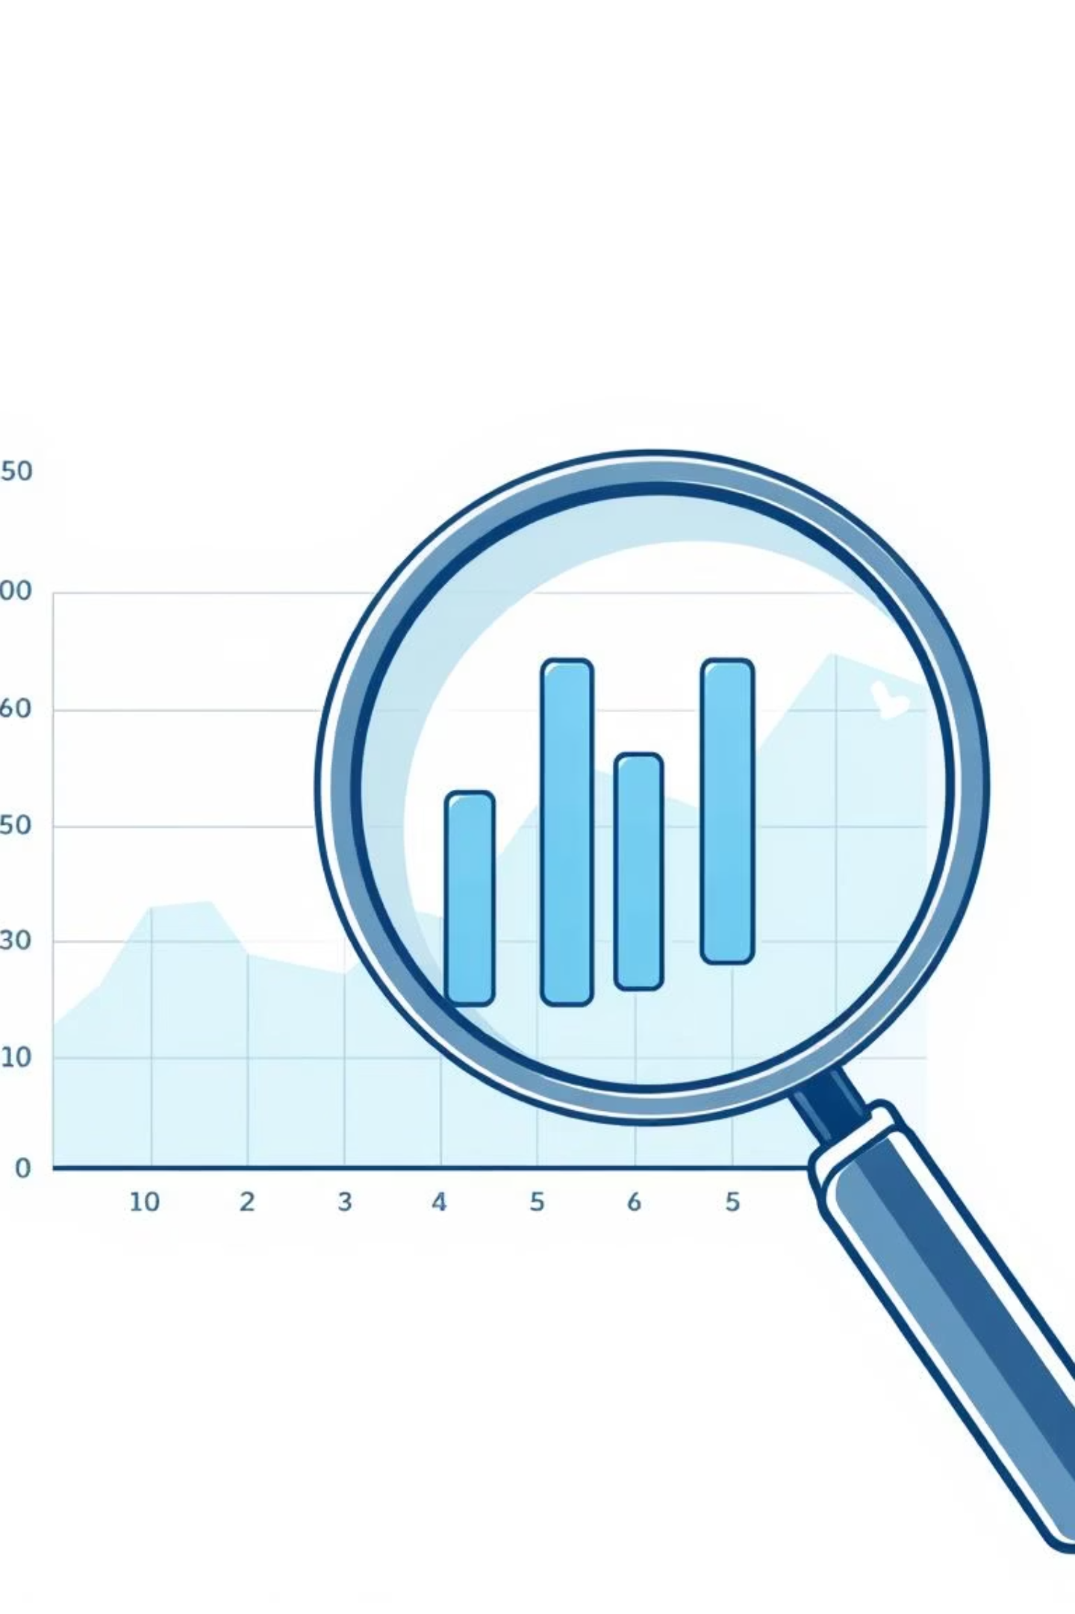






High-Value Customer Identification
Identifying high-value customers is paramount for targeted marketing and retention efforts. These customers typically exhibit higher transaction amounts and utilization rates.
High Transaction Amounts
High Utilization Ratio
Customers with consistently large total transaction values.
Customers actively using their cards for a significant portion of their credit limit.
Specific Income Brackets
Customers in the $80K - $120K and $120K+ income categories.

Slide 7
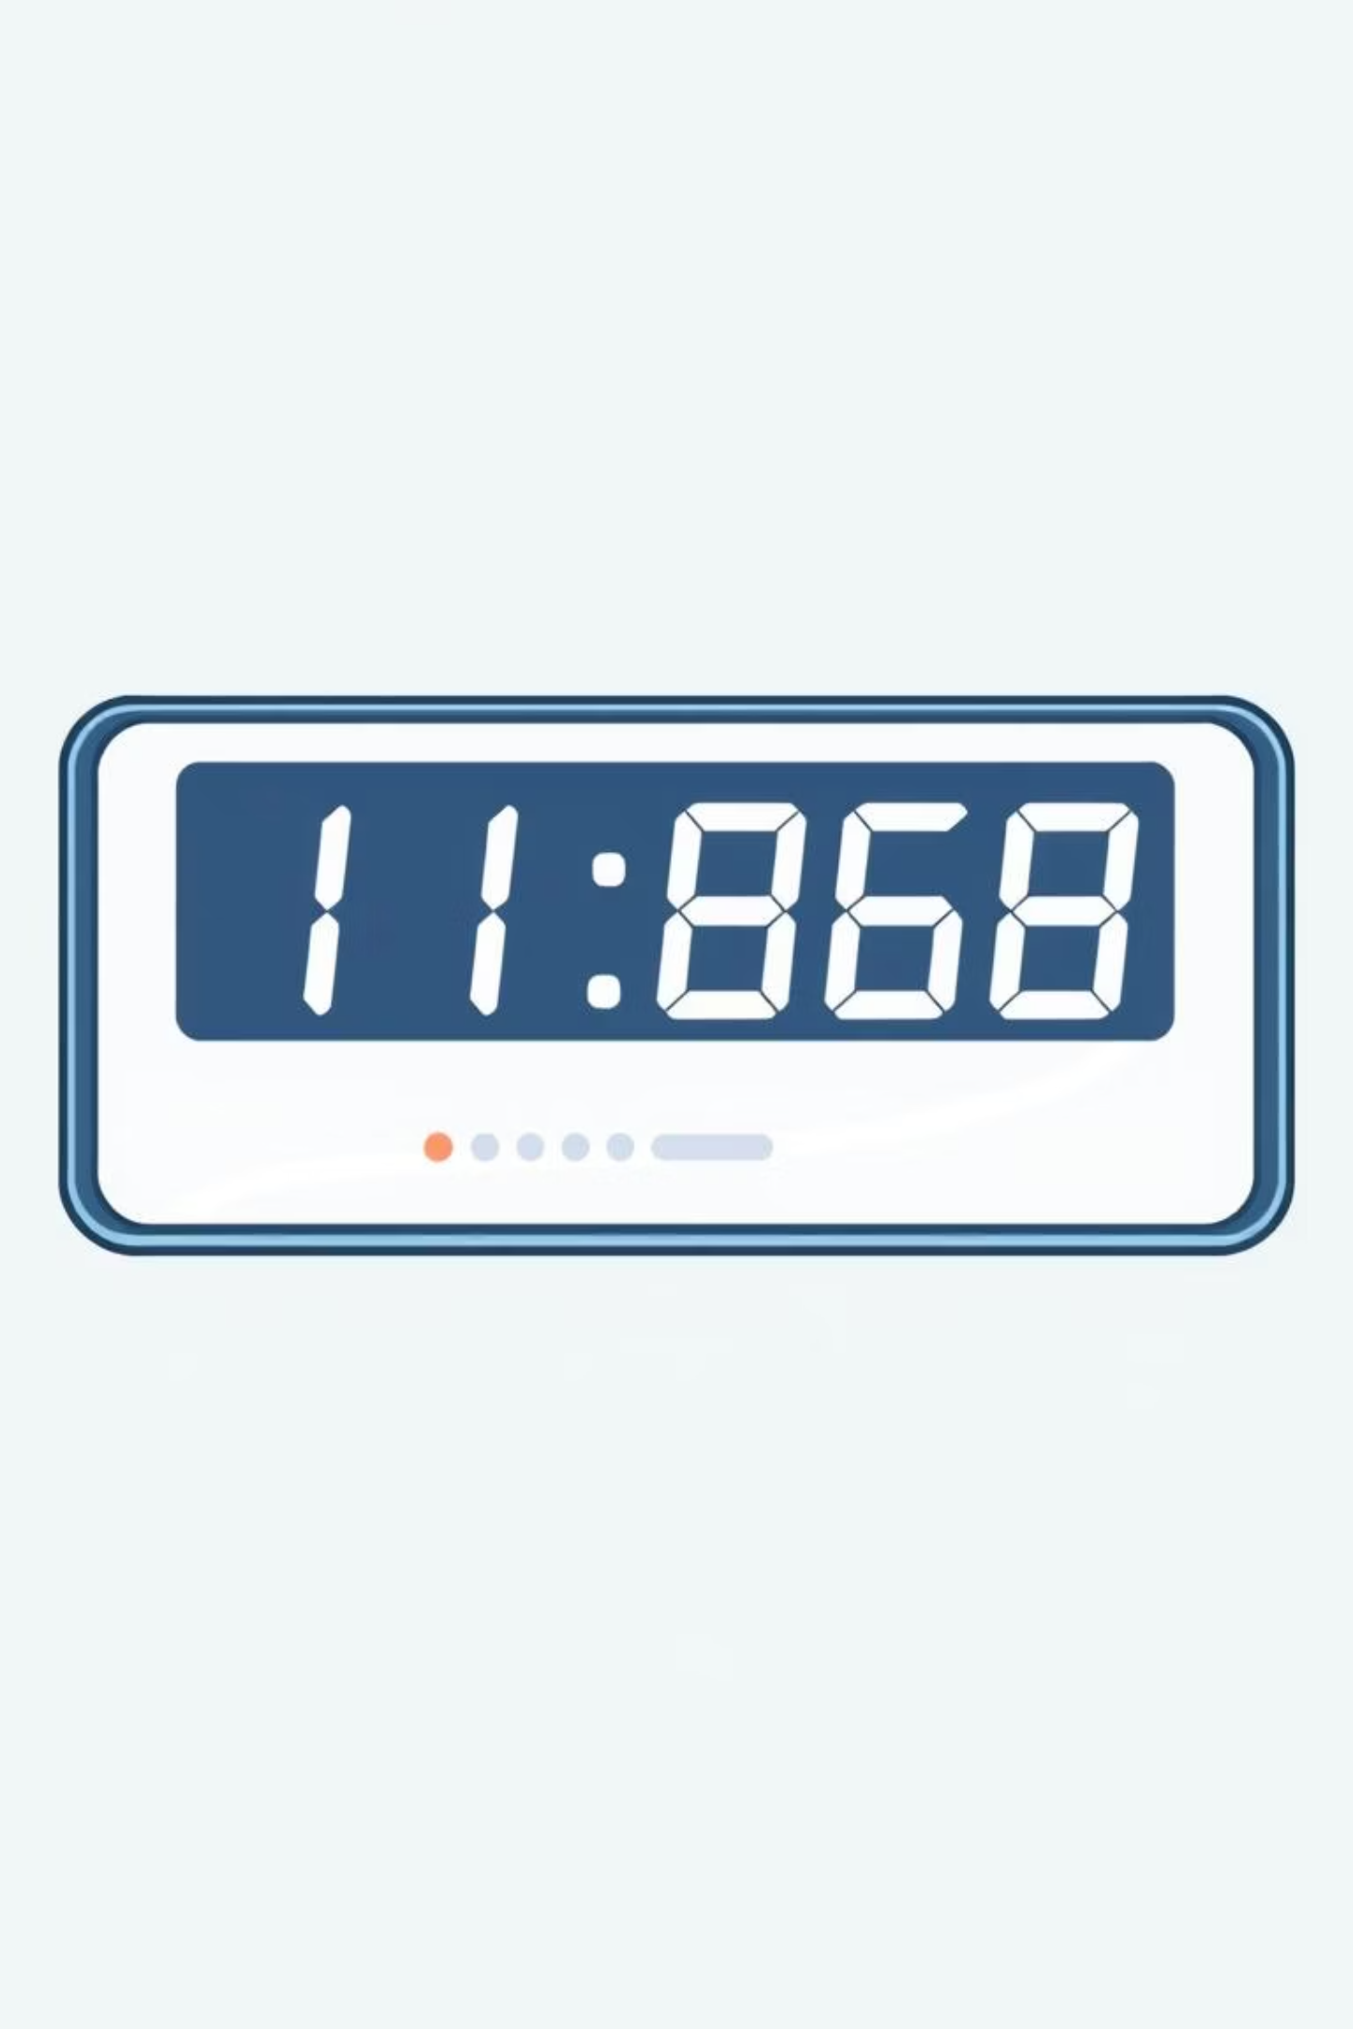



Total Transaction Count Analysis
The total transaction count provides insights into customer activity and engagement. A higher transaction count often correlates with active card usage and loyalty.
Frequent Purchases
Customers making numerous small to medium transactions.
Consistent Usage
Regular card usage throughout the month, not just for large purchases.
Engagement Indicator
Higher transaction counts signify stronger customer engagement.

Slide 8

Customer Type Segmentation
We categorise customers into 'Low', 'Moderate', and 'Active' types based on their transaction behaviour and utilization. This segmentation helps in tailoring communication and offers.
Low-Value Customers
Moderate-Value Customers
Infrequent users with low transaction amounts and utilization.
Regular users with average transaction amounts and utilization.
Active Customers
High-frequency users with significant transaction volumes and utilization.

Slide 9
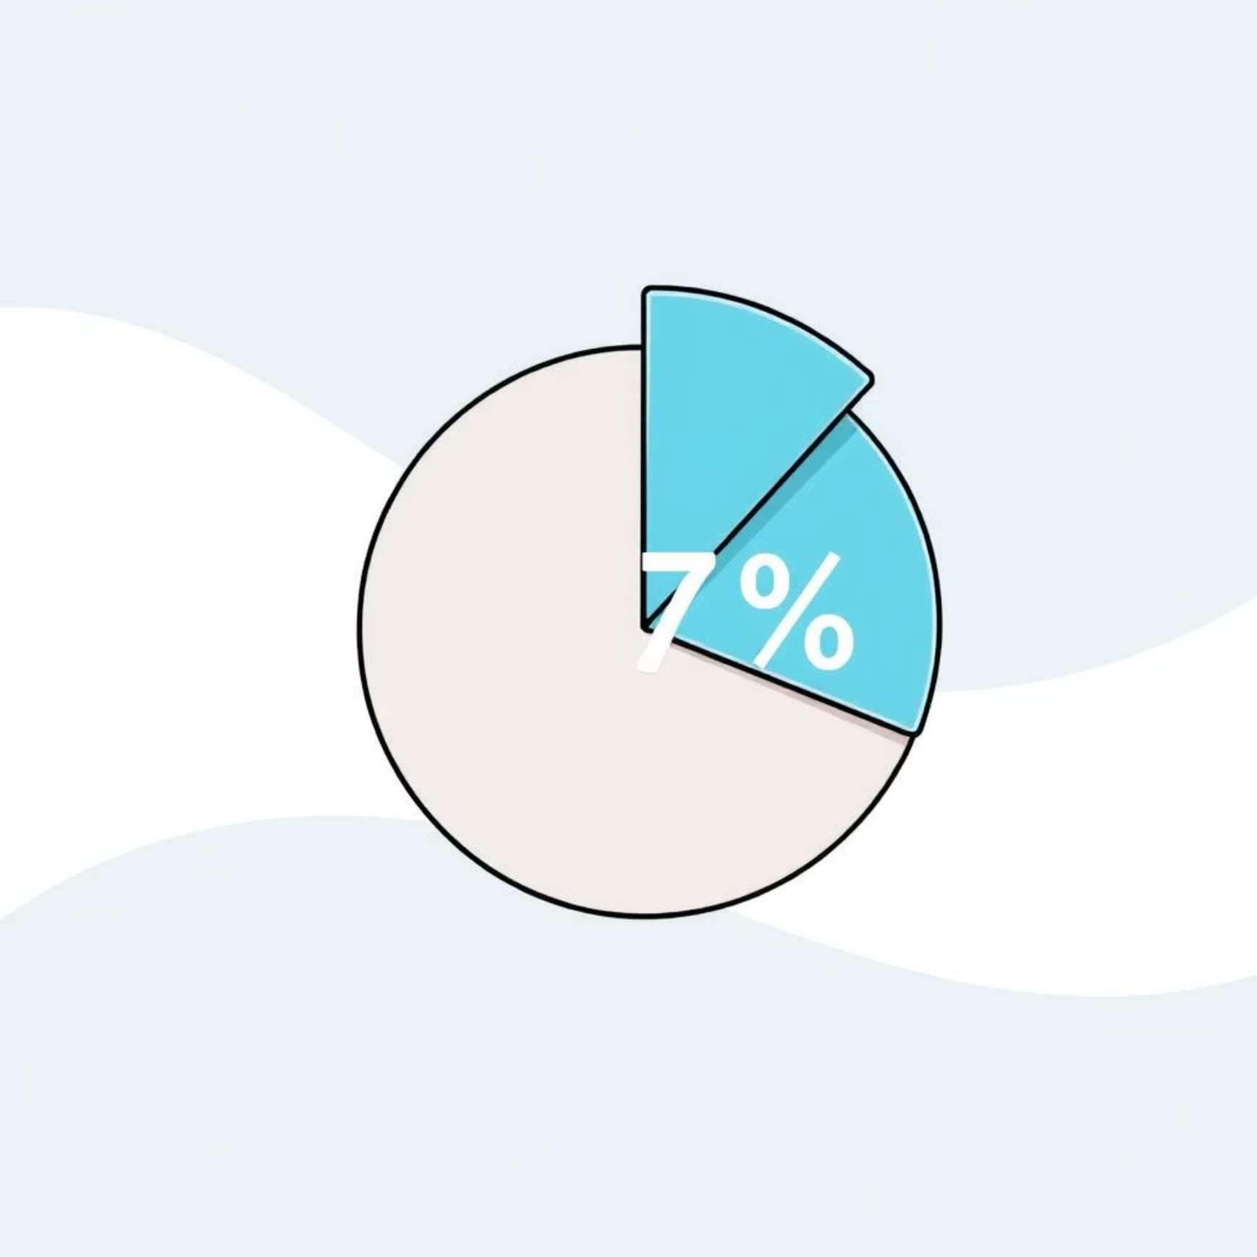
Percentage of High-Value Customers
Currently, high-value customers constitute approximately 17% of our total customer base. This segment is crucial for revenue growth and requires focused strategies.
17%
1000
Our goal is to increase this percentage through targeted campaigns and
enhanced benefits.
Current High-Value %
Total Customers
Percentage of customers identified as high-value.
Overall customer count in our database.
1468.5
27%
Avg Transaction
Avg Utilization
Average transaction amount across all customers.
Average card utilization ratio.

Slide 10






Strategic Recommendations
Targeted Campaigns
Develop specific marketing campaigns for high-value and moderate-value segments.
Enhanced Benefits
Introduce exclusive rewards and benefits for Platinum and Gold cardholders.
Increase Engagement
Promote features that encourage higher card utilization among all customer types.
Continuous Monitoring
Regularly analyse customer data to adapt strategies and identify new opportunities.

